Slide 1

Earthquake Analytics Platform on AWS
Batch & Streaming Data Pipelines using USGS API
Prathyusha Cherukuri | Data Engineer

Slide 2
Problem Statement & Goal
Problem Statement
Earthquake data is continuously published by USGS APIs
Requires near real-time monitoring
Requires historical analysis for trends
Source APIs provide limited retention by default
Project Goal
Preserve historical earthquake data in S3
Build a streaming pipeline for latest events
Build a batch processing pipeline for analytics
Design a scalable AWS data platform

Slide 3
Data Source & History Preservation
USGS Earthquake Data
One-month historical GeoJSON feed
Hourly incremental earthquake updates
History Preservation Strategy
One-time full load using one-month JSON data
Raw data stored in Amazon S3
Enables long-term historical analytics

Slide 4
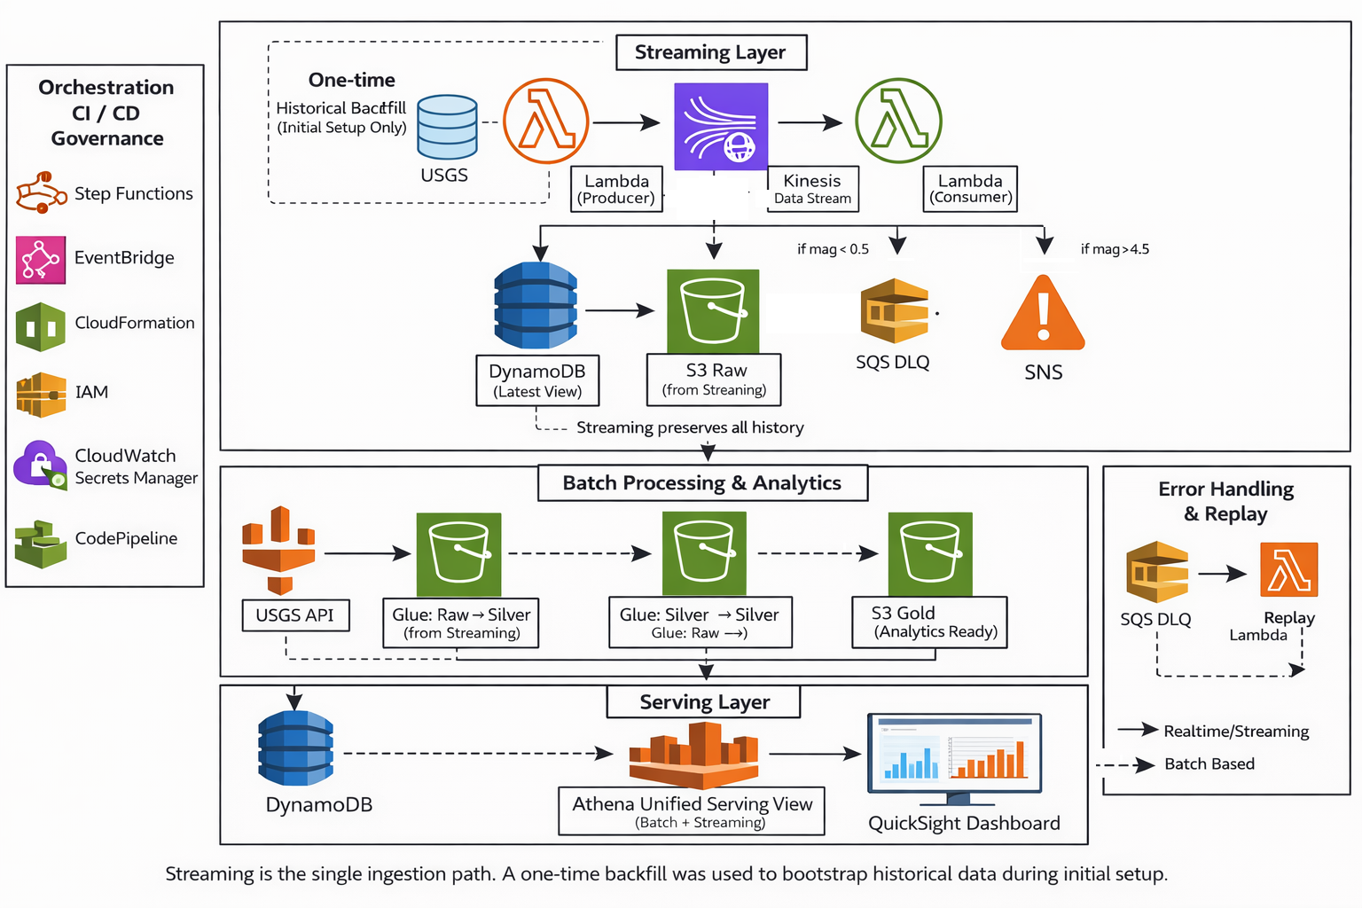
Architecture Overview

Slide 5
Streaming Pipeline (Near Real-Time Processing)
USGS API is polled every minute
Events are published to Kinesis as an internal event stream
Consumer processes events in near real time
Latest state stored in DynamoDB
EventBridge(1 min) → Lambda (Producer) → Kinesis → Lambda (Consumer)

Slide 6
Batch Processing & Analytics
Historical earthquake data stored in Amazon S3
AWS Glue processes data in batch mode
Data is cleaned, de-duplicated, and enriched
Curated datasets prepared for analytics

Slide 7
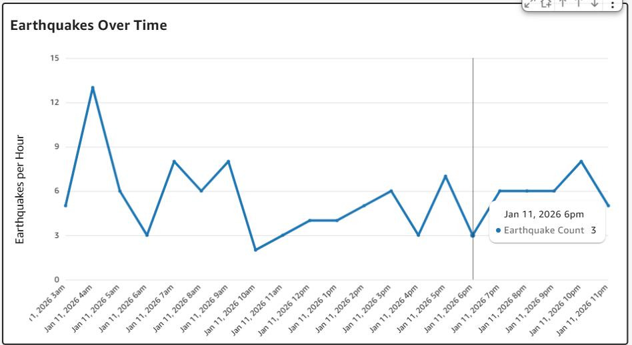
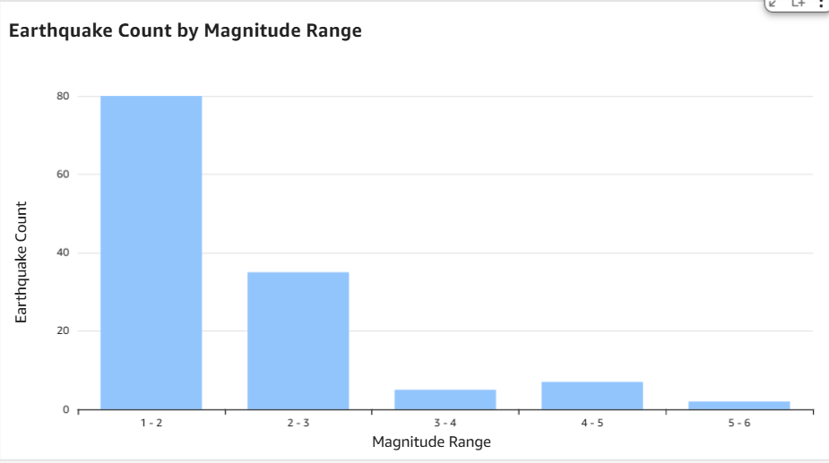
Serving Layer & Dashboarding
Amazon Athena provides a unified query layer
Curated batch and streaming data queried together
Amazon QuickSight used for interactive dashboards
Supports real-time monitoring and historical analysis

Slide 8
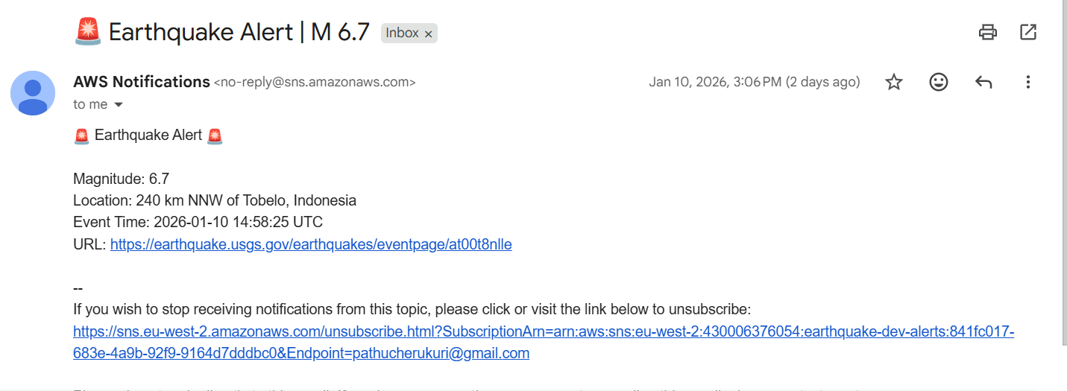
Monitoring, Alerts & Reliability
CloudWatch used for Lambda and Kinesis monitoring
SNS alerts triggered for high-magnitude earthquakes (≥ 4.5)
SQS Dead Letter Queue used for low-quality or noisy events
Replay mechanism enables recovery without data loss

Slide 9
Infrastructure as Code (IaC) & CI/CD
AWS CloudFormation provisions all infrastructure as code
Infrastructure includes Lambda, Kinesis, DynamoDB, S3, IAM, SNS, SQS
AWS CodePipeline orchestrates continuous integration and deployment
AWS CodeBuild builds, packages, and deploys application artifacts
Git Repo → CodePipeline → CodeBuild → CloudFormation → AWS Resources

Slide 10
Key Design Decisions
Streaming-first ingestion with one-time historical backfill for bootstrapping
Kinesis used as internal event backbone for decoupling components
DynamoDB optimized for low-latency latest-state access
S3 used as immutable storage for scalable analytics

Slide 11
Challenges & Learnings
Handling near real-time data freshness and dashboard latency
Designing incremental processing without duplicate records
Balancing streaming and batch workloads in a single platform
Implementing robust error handling with DLQ and replay mechanisms

Slide 12
Future Enhancements
Geo-partitioned data storage to optimize regional analysis and reduce query scope
Cost optimization through intelligent retention policies for raw and serving layers
Multi-source ingestion support to combine USGS data with other seismic providers
Apply machine learning for seismic risk scoring and anomaly detection based on historical patterns

Slide 13


